Slide 1
SESUOUS SLIDES
Slide into bed with a popular component…

Slide 2
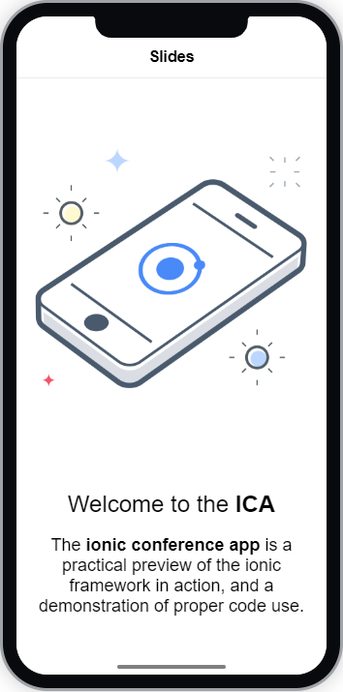

Sensuous Slides
Mostly we use slides to convey information that has been broken down into bite size chunks.
The most common use for a set of slides is to give the user instruction on how to use the application.
In actual fact, they can be used for anything
A slider is a multi-section parent that houses a group of slides.
A slide is what we call a child component of it’s parent slides

Slide 3

Sensuous Slides
As we want to dynamically interact with a slider we have the options to do a bit more work.
First we need to give the slider a name.
var slides = document.querySelector('ion-slides');
We don’t need to tell the app this is a slider - this is handled for us by using the ‘ion-slides’ tag.
For our delivery app, we are going to look at how to change some of the slider settings.
slides.options = { effect: 'flip' }

Slide 4
CHALLENGE TIME!
Create a slider for your mobile app.
For bonus points, use the Ionic Docs to find and change the slider settings.
Share a screen shot on our Discord Community!

